Slide 1
Luke 17:11-19
(English Standard Version)
2 Slides

Slide 2
¹¹ On the way to Jerusalem he was passing along between Samaria and Galilee. ¹² And as he entered a village, he was met by ten lepers, who stood at a distance ¹³ and lifted up their voices, saying, “Jesus, Master, have mercy on us.” ¹⁴ When he saw them he said to them, “Go and show yourselves to the priests.” And as they went they were cleansed.

Slide 3
¹⁵ Then one of them, when he saw that he was healed, turned back, praising God with a loud voice; ¹⁶ and he fell on his face at Jesus’ feet, giving him thanks. Now he was a Samaritan. ¹⁷ Then Jesus answered, “Were not ten cleansed? Where are the nine? ¹⁸ Was no one found to return and give praise to God except this foreigner?” ¹⁹ And he said to him, “Rise and go your way; your faith has made you well.”

Slide 5
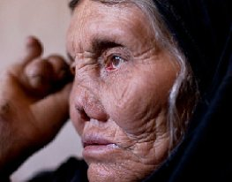
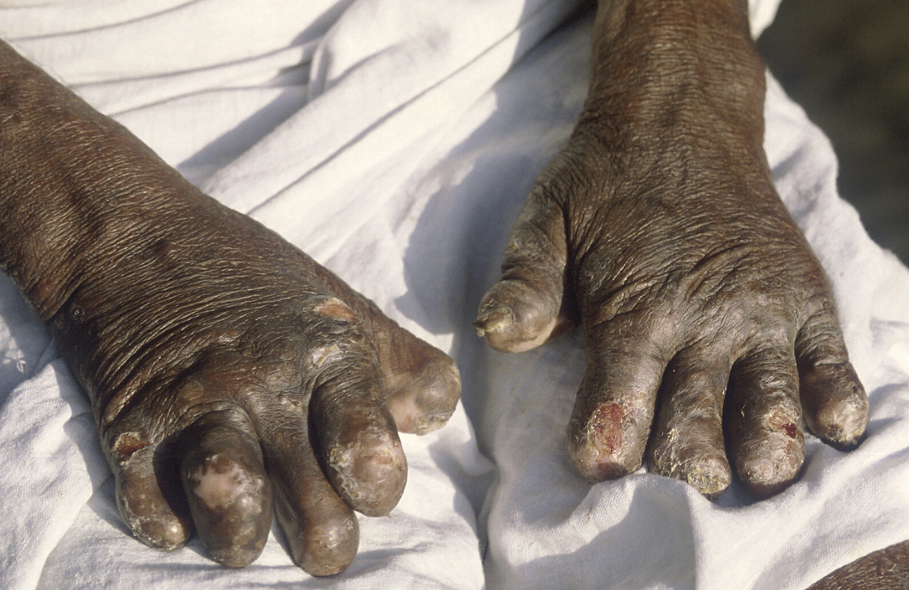
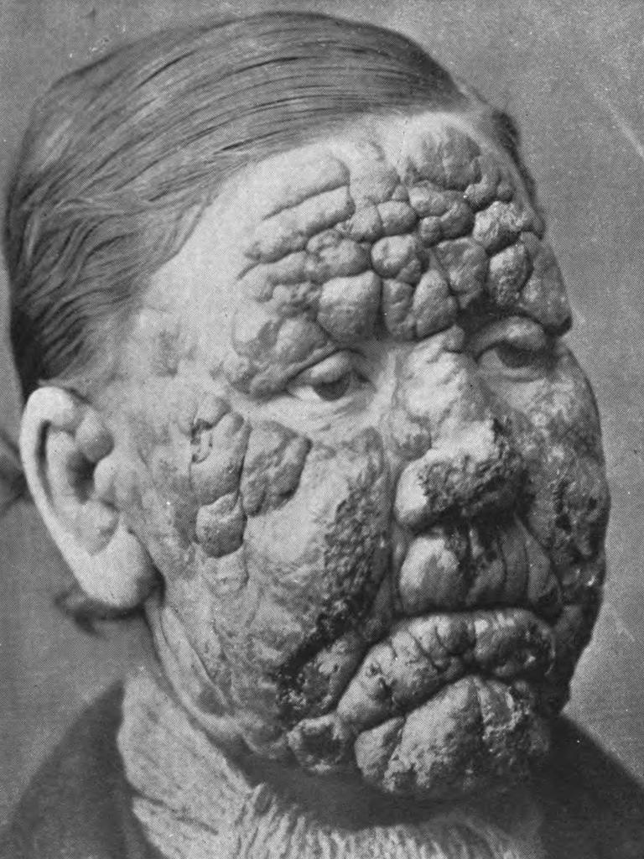
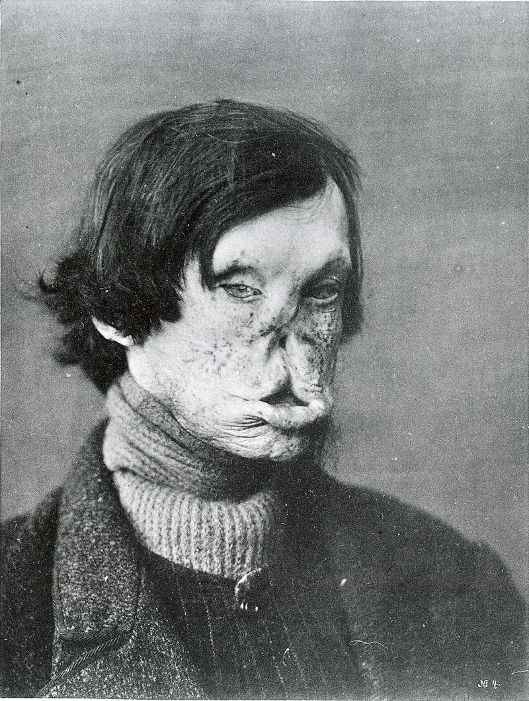

Slide 6
10 Lepers healed. 1 returns to Jesus to give thanks.
An infectious disease. Isolated from the community to prevent spread of infection.
Priests had the role of public health officials. (Diagnosed the diseased; Confirmed healing)
The healing of the 10, was an act of faith.
In obedience to Jesus, they headed off to priest to confirm healing (before they are healed).
Confirmation of their healing.
Not a “placebo” effect of hoping they are healed.
Sent to confirm healing with those who are skilled at diagnosing Leprosy.
Leviticus 13: ^{(ESV)45} “The leprous person who has the disease shall wear torn clothes and let the hair of his head hang loose, and he shall cover his upper lip and cry out, ‘Unclean, unclean.’ ⁴⁶ He shall remain unclean as long as he has the disease. He is unclean. He shall live alone. His dwelling shall be outside the camp.

Slide 7
10 Lepers healed. 1 returns to Jesus to give thanks.
An infectious disease. Isolated from the community to prevent spread of infection.
Priests had the role of public health officials. (Diagnosed the diseased; Confirmed healing)
The healing of the 10, was an act of faith.
In obedience to Jesus, they headed off to priest to confirm healing (before they are healed).
Confirmation of their healing.
Not a “placebo” effect of hoping they are healed.
Sent to confirm healing with those who are skilled at diagnosing Leprosy.
Only the Samaritan returns.
An outsider – someone not welcome at the temple.
1. Jesus takes precedence over Religious Heritage.
Importance of giving God immediate praise.
2. Praise of God, is rightly given to Jesus.
God the Son is to be worshipped, thanked and praised.
3. The Benefits of the Gospel of Jesus Christ is for persons of all backgrounds.
To become a Christian, we don’t have to first become a Jew.
Being in the presence of Jesus takes precedence over all religious duty.
4. Give Thanks.
We have so much to be thankful for.
Jesus is greater than tradition, and worthy of our praise and thanks.

